Slide 1


Predicting a Target Using Data and Math Models
By: Teyanna Williams

Slide 2
Problem and
Motivation
Predicting a target value using past data is essential for decision-making and forecasting.
Mathematical models help computers analyze patterns and trends in data to produce informed predictions.
This approach enhances accuracy and supports data-driven strategies in various fields.

Slide 3
Introduction to Methods
This presentation explores predicting a numerical target using historical data and mathematical models.
It focuses on leveraging key “features” and applying algorithms to help computers generate accurate predictions.
This demonstrates the integration of data, math, and machine learning to solve real-world problems.

Slide 4
Dataset and Features
Description
The dataset includes key features like:
Return (the gain or loss/change in price over time)
SMA_5 (Simple Moving Average; Calculates average price over a number of periods)
SMA_10 (Same as above, different period)
RSI (Relative Strength Index; momentum indicator that provides signals of overbought or oversold conditions).
These variables reflect historical performance and market momentum.

Slide 5
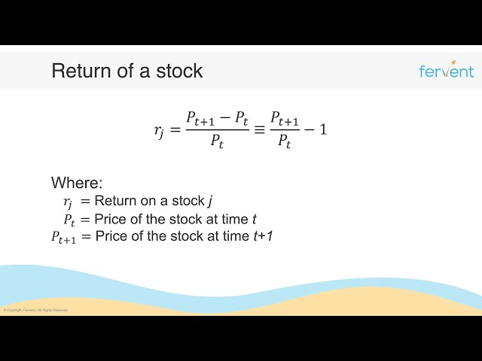
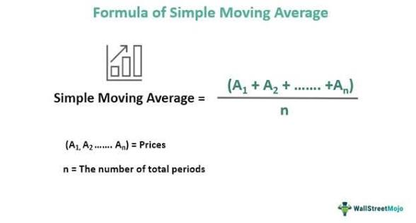
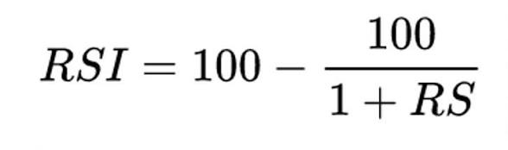
Mathematical Foundations of Features
The features used, such as Return, SMA_5, SMA_10, and RSI, are grounded in algebra and statistics.
These involve calculations like averages and ratios that capture trends and momentum.
They are vital for interpreting how features influence model predictions and for effective model training through linear combinations and probabilities.
*RS compares the performance of one asset against another

Slide 6
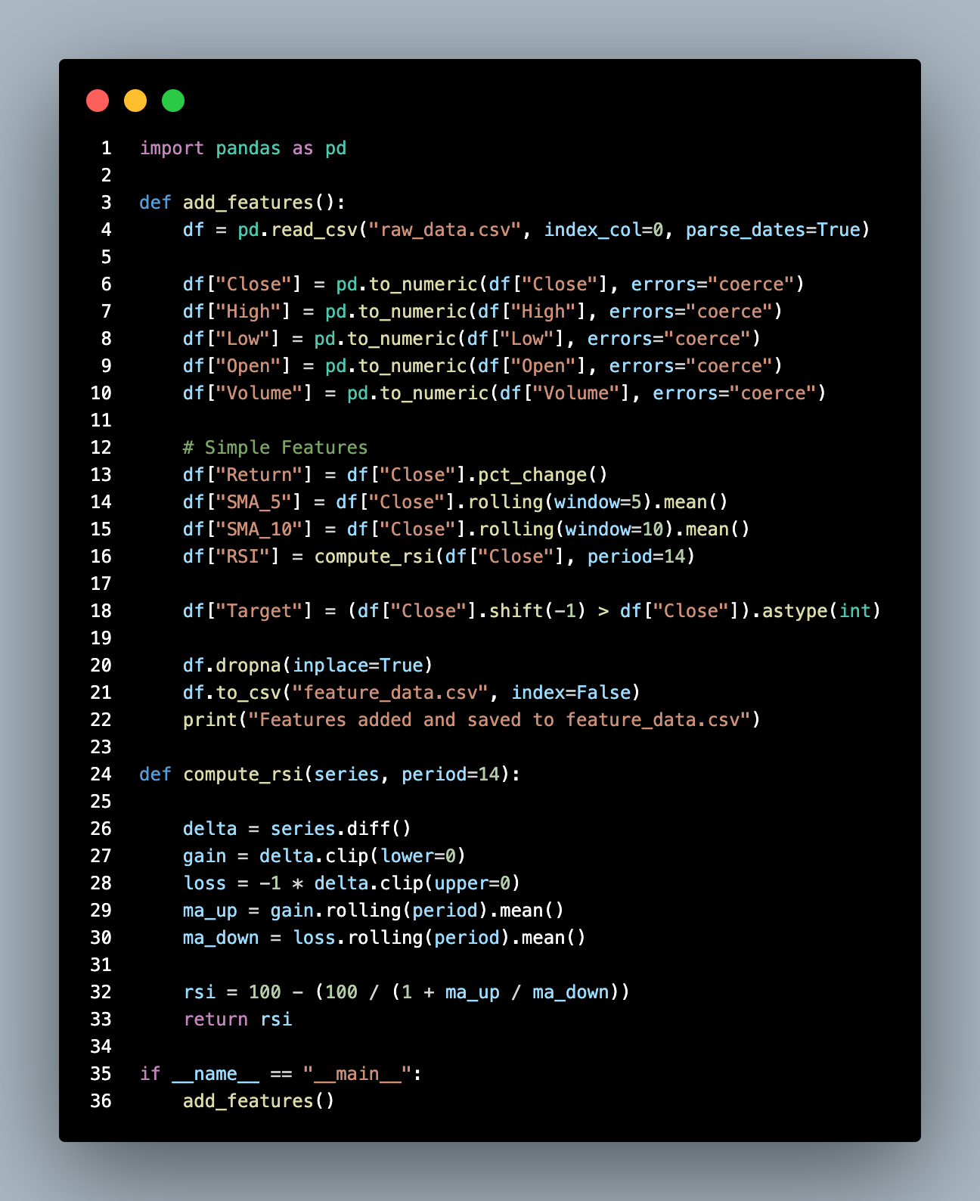
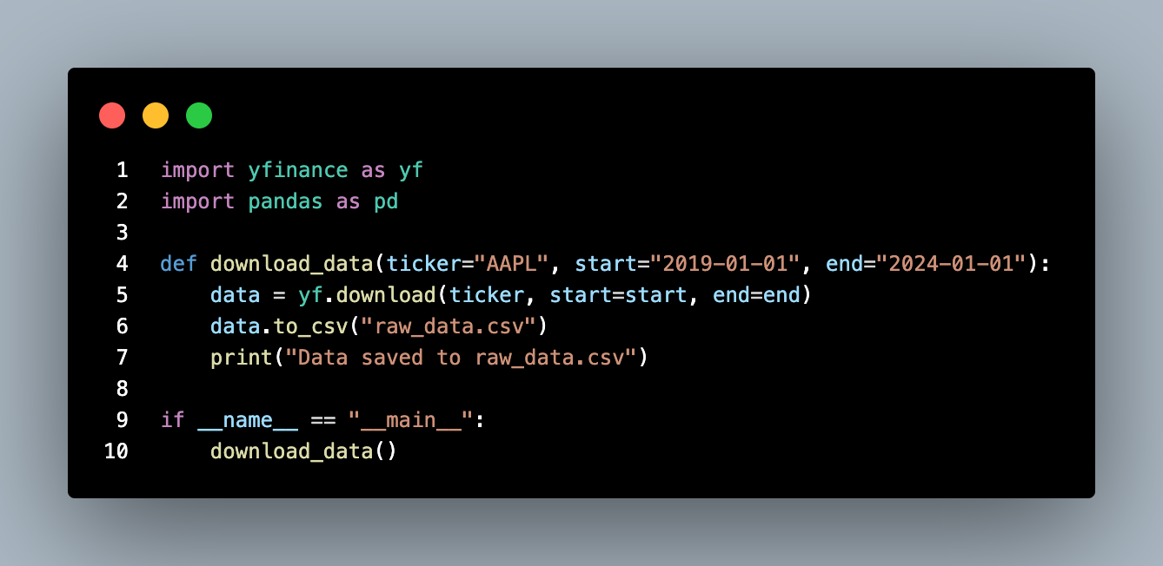
Predictive Modeling
Overview
2: Imputing Features.
1: Importing the data.

Slide 7
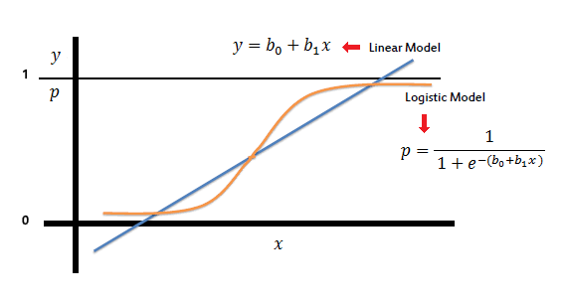
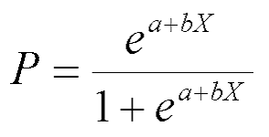
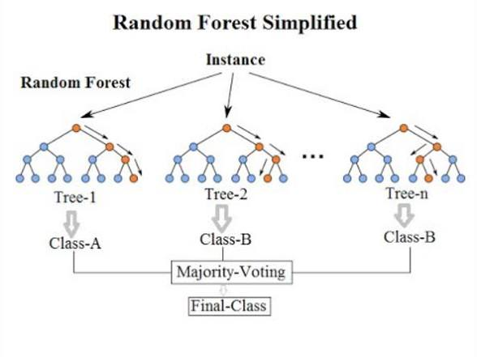
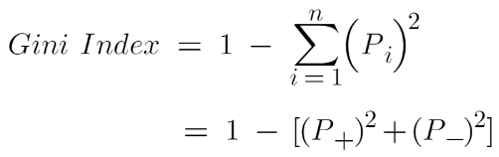
Models Used: Logistic Regression and Random Forest
Logistic Regression:
Logistic Regression uses a linear approach to estimate probabilities
Like asking your friends for advice, but some friend’s opinions count more than others. You combine their advice, then pick the most likely outcome.
Random Forest employs ensemble decision trees to capture complex patterns.
Like having a committee of experts, and each expert asks a simple yes or no question about the data and makes a prediction. Then you combine all their predictions to get a final answer.
Both models utilize the features to predict the target, offering complementary strengths in handling linearity and non-linearity in data.
Random Forest:

Slide 8
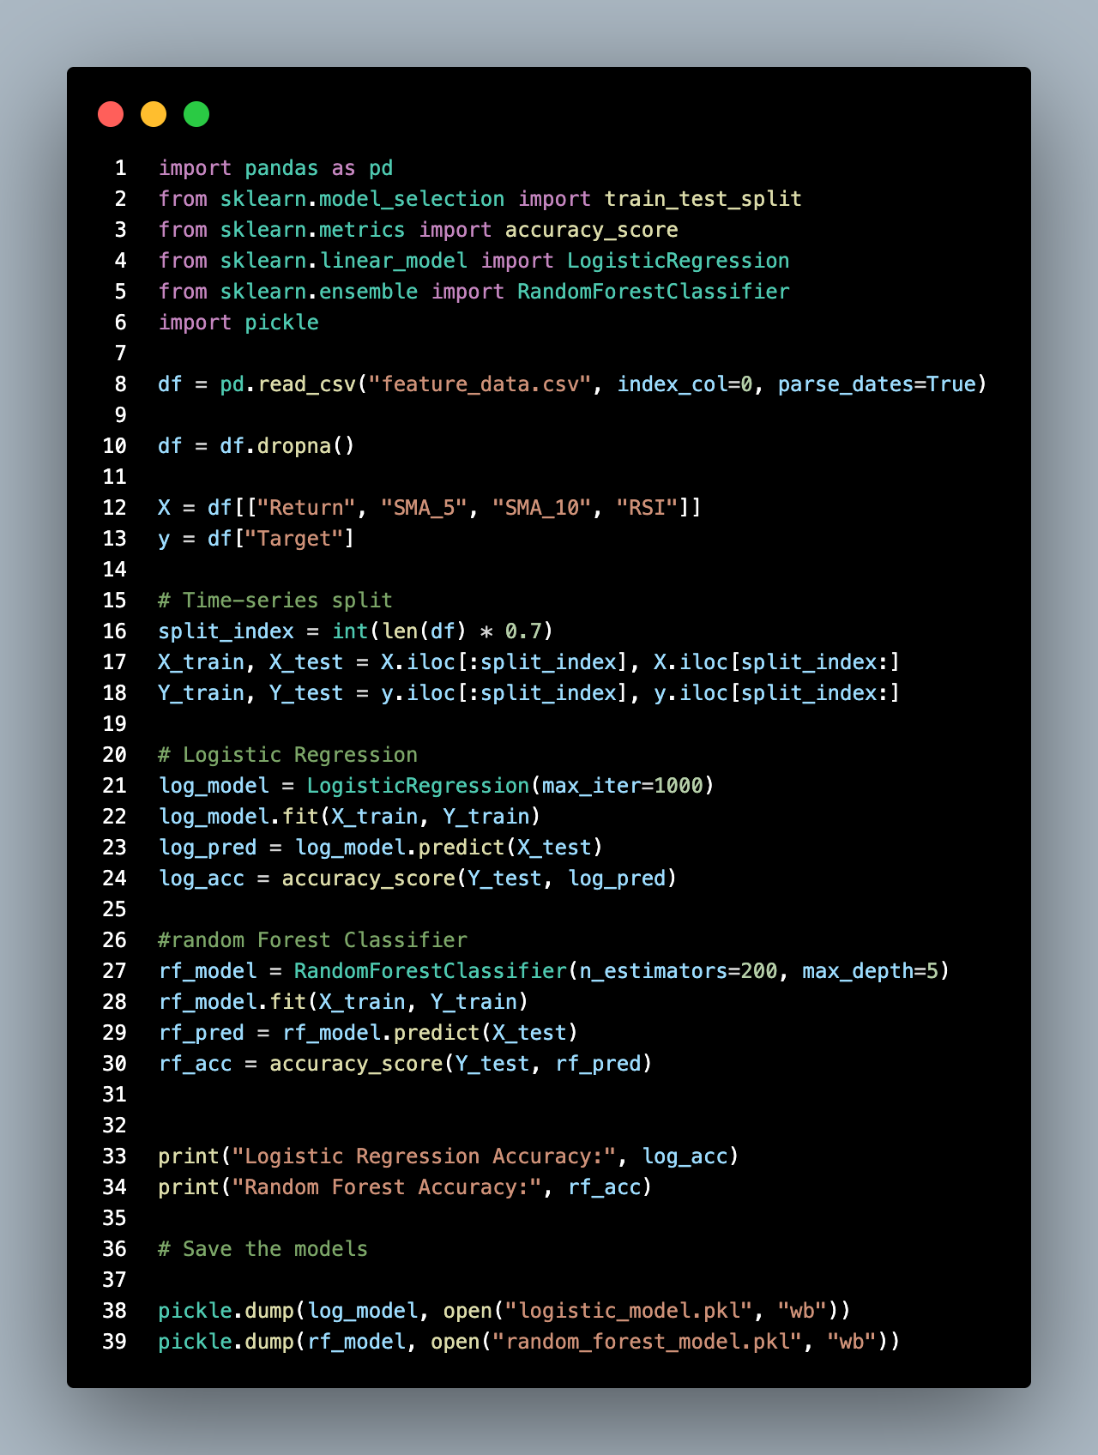
Model Implementation and
Analysis

Slide 9
Evaluation Metrics and
Visualization
Model performance was assessed using metrics like:
MAE (Mean Absolute Error),
On average, how far off were they?
MSE (Mean Squared Error),
Penalizes mistakes more heavily, so the model tries to avoid large errors.
R² (Coefficient of Determination),
How much variation in the data can the model explain?
and percentage of wins.
A comparison of how accurate the two models were.
Visual plots illustrate prediction accuracy and error distribution, providing insight into model reliability and comparative effectiveness on the dataset.

Slide 10
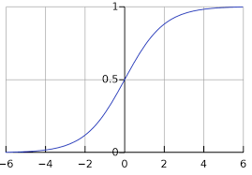

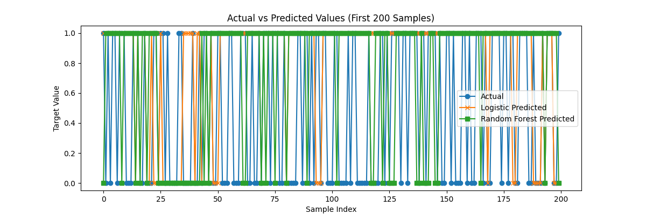
--- Logistic Regression ---
Mean Absolute Error: (MAE): 0.5027
Mean Squared Error (MSE): 0.5027
R^2 Score: -1.0154
--- Random Forest ---
Mean Absolute Error: (MAE): 0.5053
Mean Squared Error (MSE): 0.5053
R^2 Score: -1.0261
=== Model Comparison Summary ===
Logistic Regression performs better based on MAE. (lower is better)
Logistic Regression performs better based on MSE. (lower is better)
Logistic Regression performs better based on R^2 Score. (higher is better)
Winner Summary (entire test set of 374 samples):
Logistic Regression wins: 33 (8.82%)
Random Forest wins: 32 (8.56%)
Ties: 309 (82.62%)

Slide 11
Key Observations and Future
Directions
Both models performed similarly; however, Logistic Regression showed a slight edge in accuracy.
This analysis highlights the importance of feature impact and model selection.
Future work will focus on scaling the project and refining feature sets to enhance predictive power for larger, more complex datasets.

Slide 12


Conclusions
The project demonstrated effective use of mathematical features and two predictive models to forecast a target variable. Logistic Regression performed slightly better, but both models are valuable for model comparison and understanding feature contributions. Moving forward, expanding the feature set and project scale will further improve prediction accuracy and practical application.

